Slide 1
Visualisation and forecast of Stock Data using DASH
Project Members
Niladri Sen (33200120064)
Anjali Burnwal (33200120059)
Under the guidance of
Mr. Subhankar Guha
Assistant Professor of CSE department

Slide 2
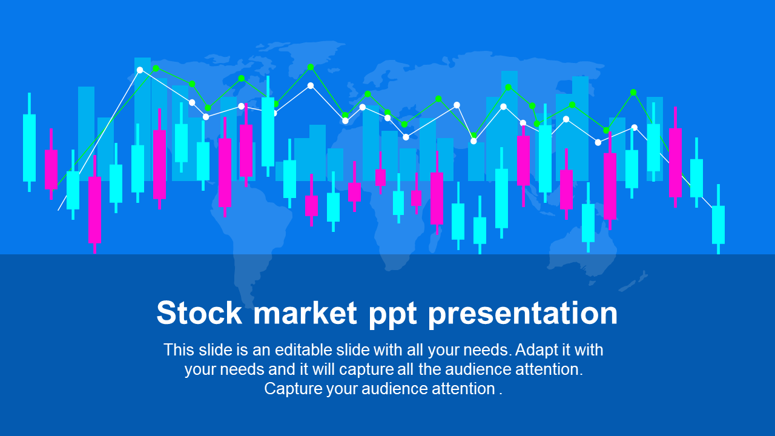
Objective:
WE WILL BE CREATING A SINGLE-PAGE WEB APPLICATION USING DASH (A PYTHON FRAMEWORK) AND SOME MACHINE LEARNING MODELS WHICH WILL SHOW COMPANY INFORMATION (LOGO, REGISTERED NAME AND DESCRIPTION) AND STOCK PLOTS BASED ON THE STOCK CODE GIVEN BY THE USER. ALSO THE ML MODEL WILL ENABLE THE USER TO GET PREDICTED STOCK PRICES FOR THE DATE INPUTTED BY THE USER.

Slide 3
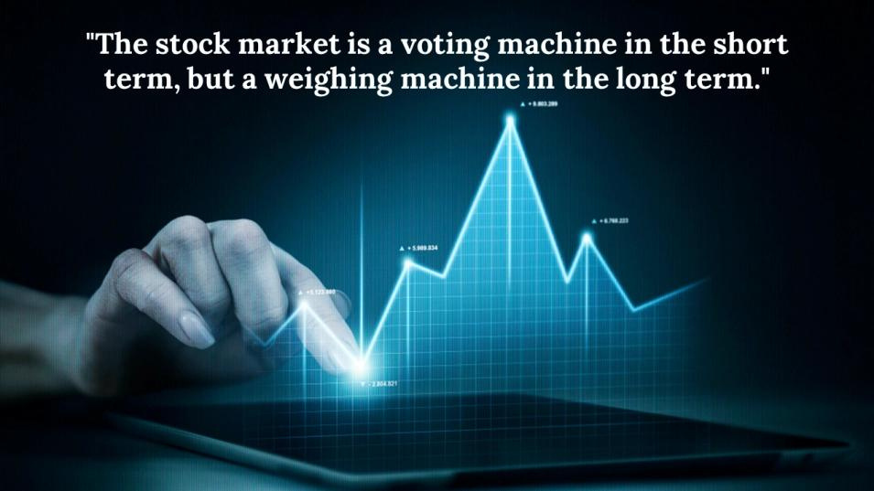
Stock investments provide one of the highest returns in the market. Even though they are volatile in nature, one can visualise share prices and other statistical factors which helps the keen investors carefully decide on which company they want to spend their earnings on.
Developing this simple project idea using the Dash library (of Python), we can make dynamic plots of the financial data of a specific company by using the tabular data provided by yfinance python library. On top of it we can use a machine learning algorithm namely SVR(Support Vector Regression) to predict the upcoming stock prices up to 30 days.
CONTEXT
PROJECT

Slide 4
Project Stages
1
2
3
4
Input stock code to get company information
Select date range to get stock price and estimated moving average plots
Input number of days to get forecast
Deployment on Cloud Application Platform

Slide 5

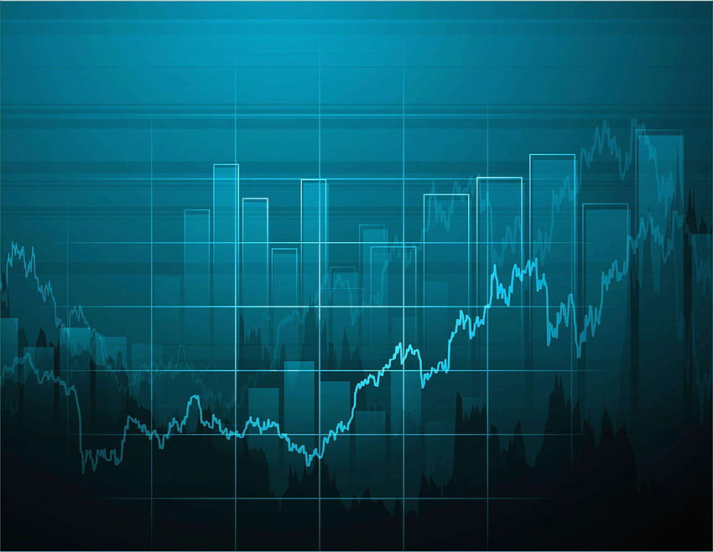
High-Level Approach:
Make the main website's structure using mainly Dash HTML Components and Dash Core Components.
Enhance the site's UI by styling using CSS
Generate plots of data using the plotly library of Python. The data is fetched using yfinance python library
Implement a machine learning model to predict the stock price for the dates requested by the user.
Deploy the project on Heroku(It is a cloud platform-as-a-service (PaaS)) to host the application live.

Slide 6
Thank You
December 2023

